Slide 1
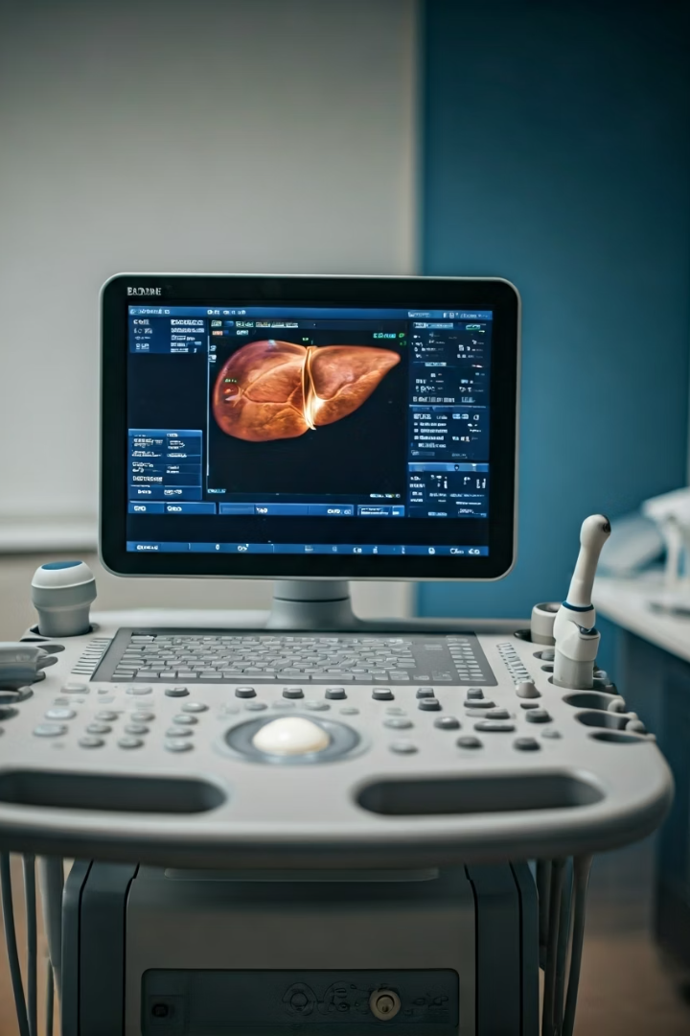

Ultrasound for Fatty Liver
Ultrasound for Fatty Liver is a simple, painless, and safe test that helps doctors see if there is too much fat in the liver. It uses sound waves (not radiation) to create pictures of the liver.
What is an Ultrasound?
An ultrasound is a test where a small device called a probe is moved on your stomach. This device sends sound waves into your body, and the waves bounce back to create images of your organs — like your liver.
by Ram N Java

Slide 2
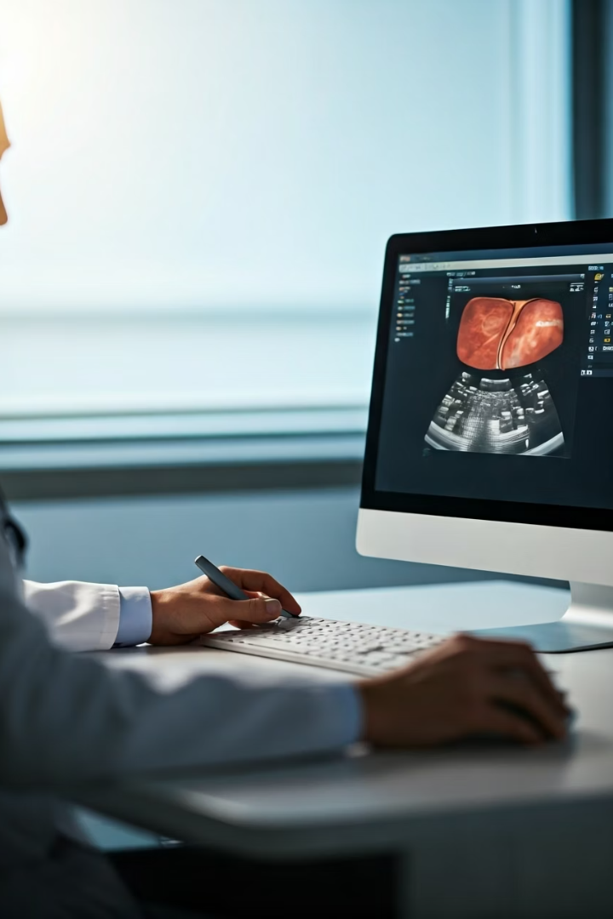




Why Do Doctors Use Ultrasound for Fatty Liver?
Check if fat is building up in the liver
See the size and texture of the liver
Detect early signs of liver problems
Help find the grade or stage of fatty liver

Slide 3
How It Works
Patient Position
You lie down on a bed
Gel Application
A warm gel is put on your belly to help move the probe
Scanning Process
The probe is moved over your upper belly (where your liver is)
Duration
The test takes about 10 to 15 minutes
Comfort Level
It does not hurt and there are no needles

Slide 4
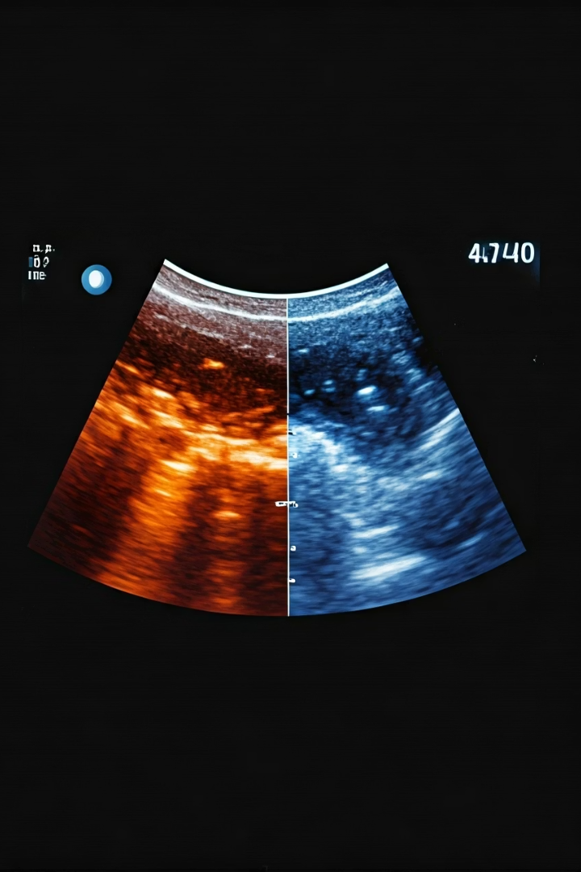
What Doctors Look For
Brightness
Size
If the liver looks
brighter than normal (called "echogenicity") – this shows fat
If the liver is larger than normal
Severity
If fat is mild, moderate, or severe

Slide 5
Is It Accurate?
Accuracy
Why It's Commonly Used
Ultrasound is very good for spotting
moderate to severe fatty liver. But it may not catch early (mild) fat buildup.
Safe
Easy
Affordable
Widely available
Still, it is the most common first test because of these benefits.

Slide 6
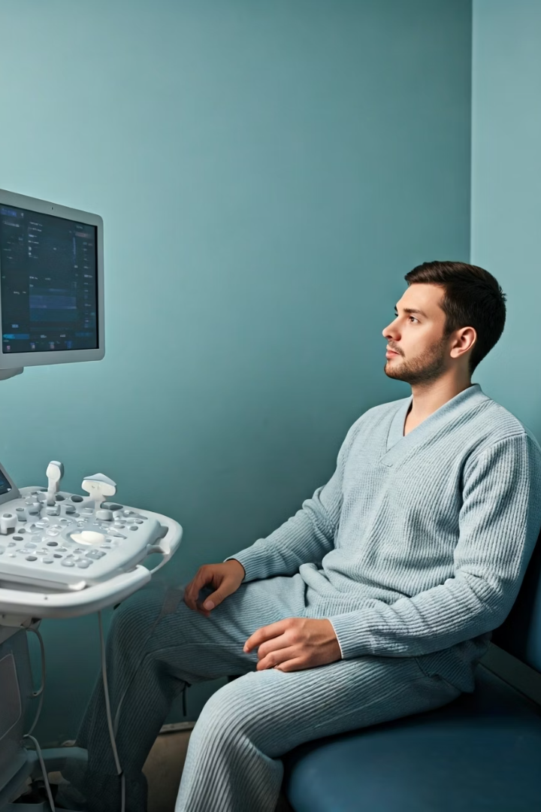


Do You Need to Prepare?
Fasting
Clothing
Avoid eating for 6–8 hours before the test (to reduce gas in the stomach)
Wear loose clothing for comfort

Slide 7
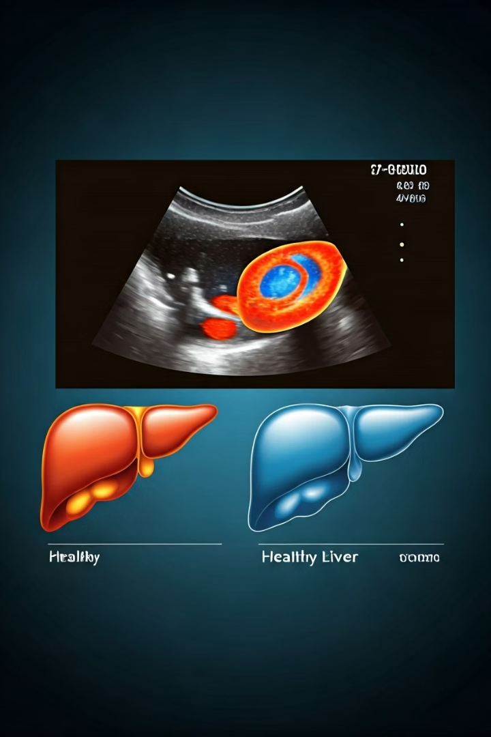
Fatty Liver Grades on Ultrasound
Grade 0 – Normal Liver
No fat in the liver
Liver looks clear and smooth on ultrasound
This is a healthy liver
Grade 1 – Mild Fatty Liver
Small amount of fat in the liver
Liver looks a little brighter than normal
Most people have no symptoms
Reversible with better diet and lifestyle

Slide 8
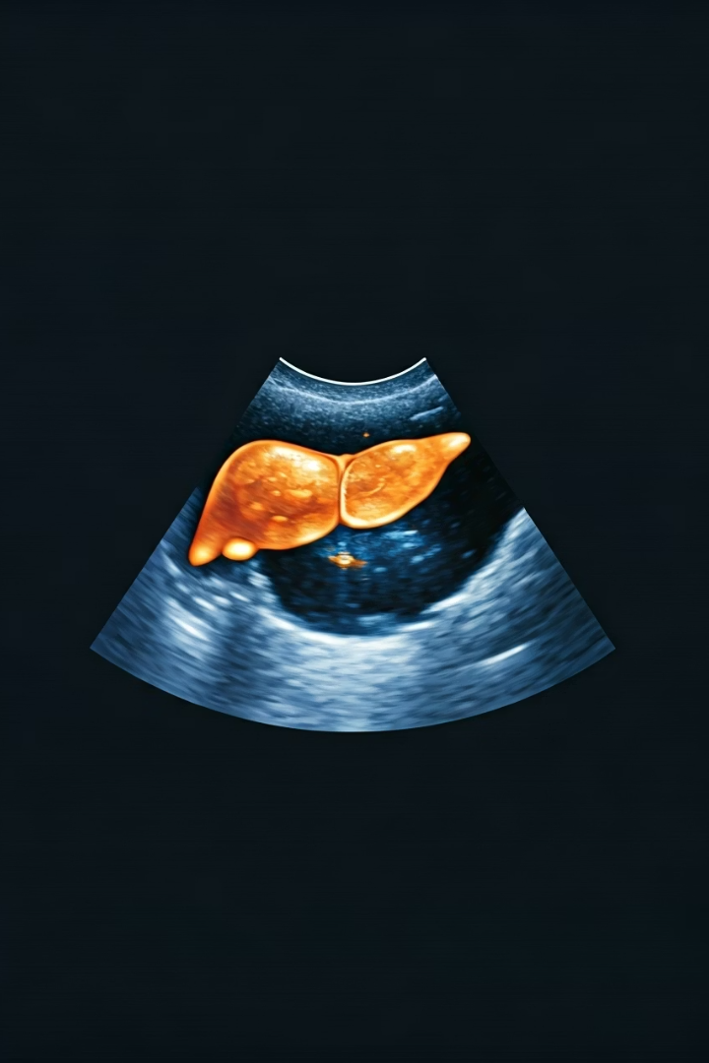
Fatty Liver Grades on Ultrasound
Grade 2 – Moderate Fatty Liver
More fat seen in the liver
Liver looks much brighter
Blood vessels may start to look unclear
Still reversible with proper care
May start to show some symptoms like tiredness or heaviness
Grade 3 – Severe Fatty Liver
A lot of fat in the liver
Liver is very bright and unclear
Blood vessels are hard to see
May lead to liver inflammation or damage
Needs serious lifestyle changes and medical follow-up
Still possibly reversible if treated early

Slide 9

Fatty Liver Grades on Ultrasound
Grade 4 – (Sometimes used)
Not always listed in basic grading, but in some reports, Grade 4 may refer to NASH (Non-Alcoholic Steatohepatitis)or fibrosis/cirrhosis
This means the liver has inflammation and scarring, not just fat
Usually not fully reversible
Important Points
Grade 1 and 2 are common and reversible
Grade 3 and above need medical care and regular check-ups
Fatty liver often has no symptoms, so ultrasound helps find it early

Slide 10




Conclusion
Simple Test
Detection
Next Steps
Safe, painless procedure
Finds fat in the liver
Guides treatment decisions
An ultrasound for fatty liver is a simple and safe way to find out if there is too much fat in your liver. It helps your doctor decide what to do next to protect your liver.

